Slide 1
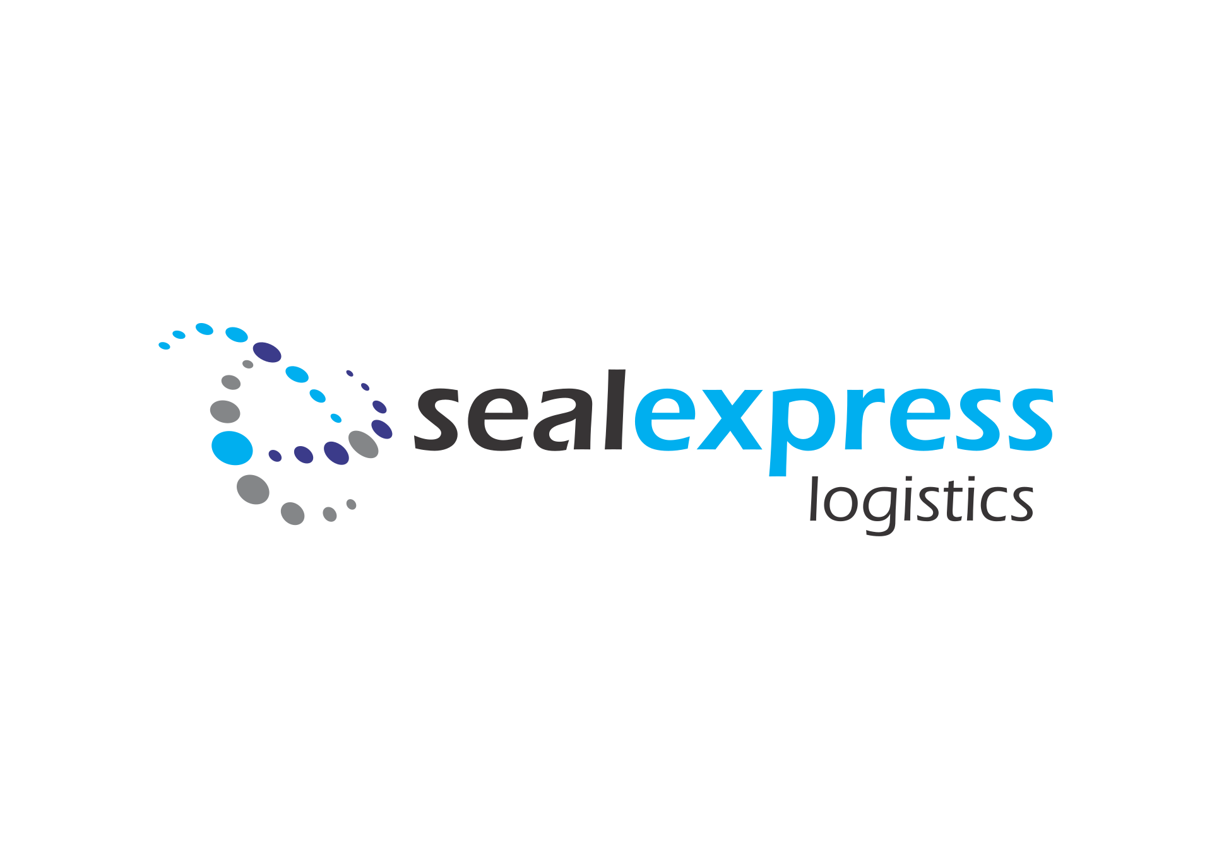
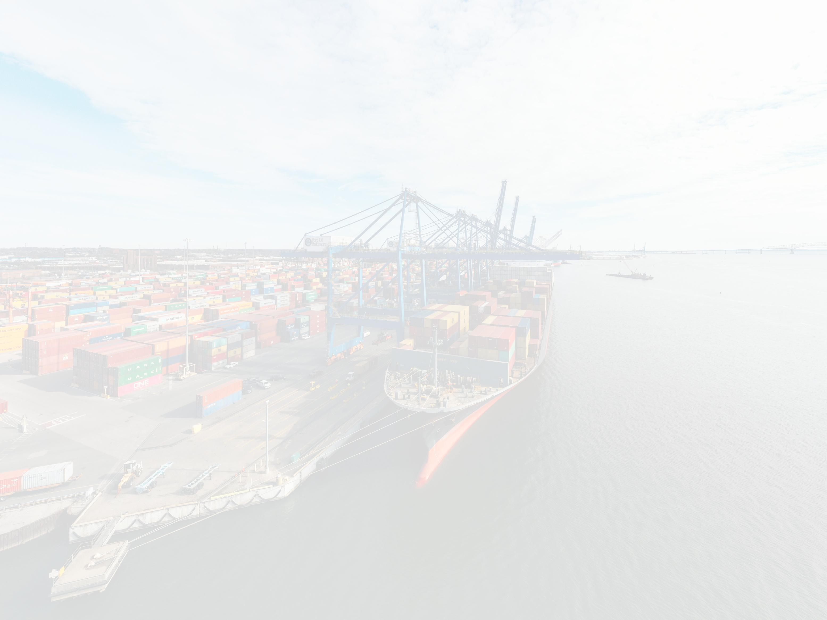


Setting new standards

Slide 2

WELCOME TO OUR COMPANY
SEAL Express Logistics is a premium provider of integrated logistics services. It is our mission to offer our business partners a comprehensive "one-stop-shop'" service concept with focus on the Black Sea and Central/ Eastern Europe backed by global coverage capability.
Our policy can be described in a few words as "high quality and competitive services grounded on our rock solid professionalism and upright behavior".

Slide 3

WE HAVE DONE THIS FOR OVER 20 YEARS
Our staff is formed of skilled specialists with more than 20 years of experience in the field of freight forwarding. With a solid background in all areas of freight forwarding such as sea freight, air freight, logistics, express service, project based logistic solutions, we represent one of the most professional options for all your logistics needs.
Whether it is normal cargo or sensitive parcels, you can rest assured that we can deliver both quality and reliable services throughout the world and exceed even the most eccentric needs for your shipments.

Slide 4
OUR SERVICES
SEA FREIGHT
AIR FREIGHT
INLAND SERVICES
CONTAINERIZED AND BREAK BULK TRANSPORTATION
TIME EFFECTIVE SHIPMENTS
CONTROLLED SHIPMENTS
  Shipment of cargo from/ to Romania to/ from any location in the world
  Cross bookings - shipment of cargo from/ to anywhere in the world
  Global consolidations
  Documentation management
  DOOR DELIVERY for both import or export to/ from Romania
  Inland transportation by truck or rail
  Cargo transshipment from/ to container to/ from other mean of transportation.
General Dry Cargo: any items which do not contain liquid, such as textiles, retail or consumer goods, machinery and hardware, electronics, etc.:
  Temperature Controlled Cargo
  Hazardous Material/ Dangerous Goods
  Heavy weight and over dimensional freight
  High Value/ Fragile Items.
Haulage services
  Port-to-consignee movement of full containers
  Inland coordination following vessel arrival and terminal release
  Container haulage integrated with sea freight operations
  Local execution with direct operational coordination.

Slide 5
OUR SERVICES
LIQUID BULK: FLEXITANK
CEREALS CONTAINERISATION FACILITY
WAREHOUSING
In flexitank it is possible to transport almost any non-hazardous liquids, both for industrial use and food application, such as: white oils, palm oil, ricin oleic acid, transformer oils, edible oils, lactic acid, vegetable oils, additives, drinking water, waxes, aluminum chlorhydroxide, fruit concentrates, detergents, sweeteners, emulsions, malt extract, glycerol, natural latex, synthetic latex, lubricants, glycerin, ink, fertilizers, latex, etc.
Our facility consists of a complex solution of containerization and de-containerization of bulk cargoes with a stuffing/ stripping capacity of 1.500 Mt./ 60x20' containers per day, located on the pier, within free port bonded area, inside the largest container terminal in the Black Sea.
As part of its integrated services, SEAL Express Logistics offers storage facilities (bounded or non-bounded warehouse) for general or refrigerated/ frozen products. Through its network of partners, SEAL Express Logistics is able to offer flexible storage solutions, based on particular necessities of each client:
  Storage for general goods and refrigerated/ frozen products
  Packing/ unpacking
  Palletizing
  Picking
  Quality security system
  Inventory control management.

Slide 6
OUR SERVICES
CUSTOMS CLEARANCE FORMALITIES
CARGO INSURANCE
PROJECT CARGO
ISEAL Express Logistics offers assistance for customs clearance formalities through its sub-contractors making this process a smooth experience for you and helping you to save precious time.
Your cargo is as important to us as it is to you. Even though we take all measures to ensure safe﻿ handling of your cargo, unforeseeable accidents may happen; we therefore advise all our clients to apply for additional insurance.
Project cargo shipments require special expertise, dedication, concentration and particular solutions. Regardless of the shipment's route, our team handles every consignment in a professional manner, planning and engineering all the required points in detail.
Our projects logistic services include:
  Import/ export customs clearance
  Transit formalities and guarantee
  Bounded warehousing
  ATA document
  TIR document
  Any other related services by request.
We can offer additional insurance through our broker or provide a list of reliable insur﻿ance brokers which you may contact.
  Project cargo multi-modal transportation
  Project cargo handling, including lashing & securing
  Project cargo storage
  Operations survey
  Customs clearance.

Slide 7
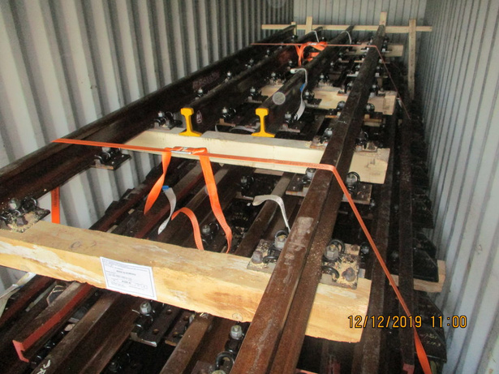
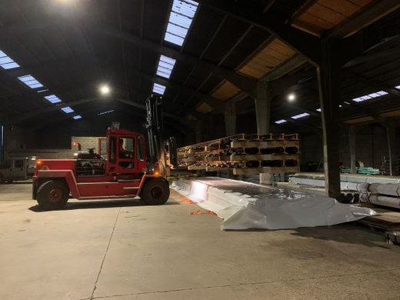
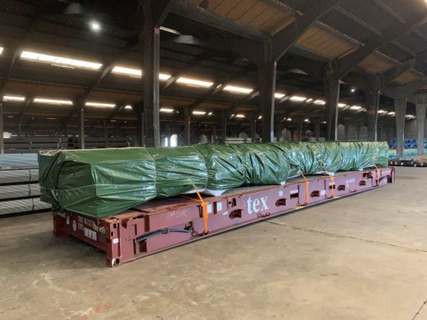
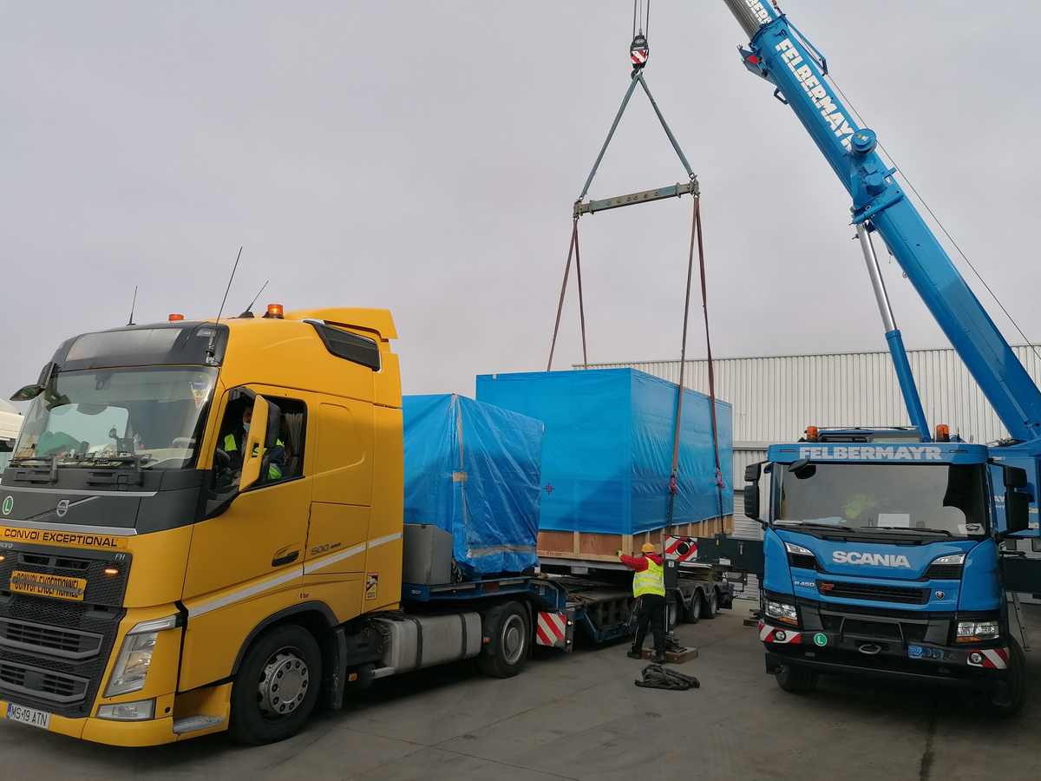
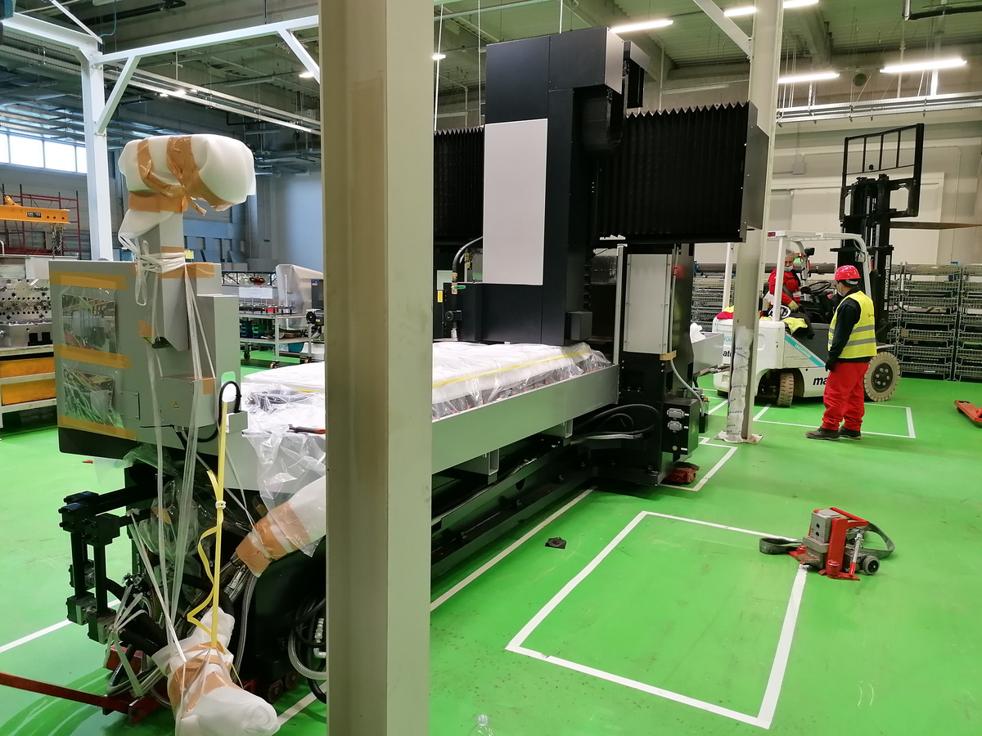
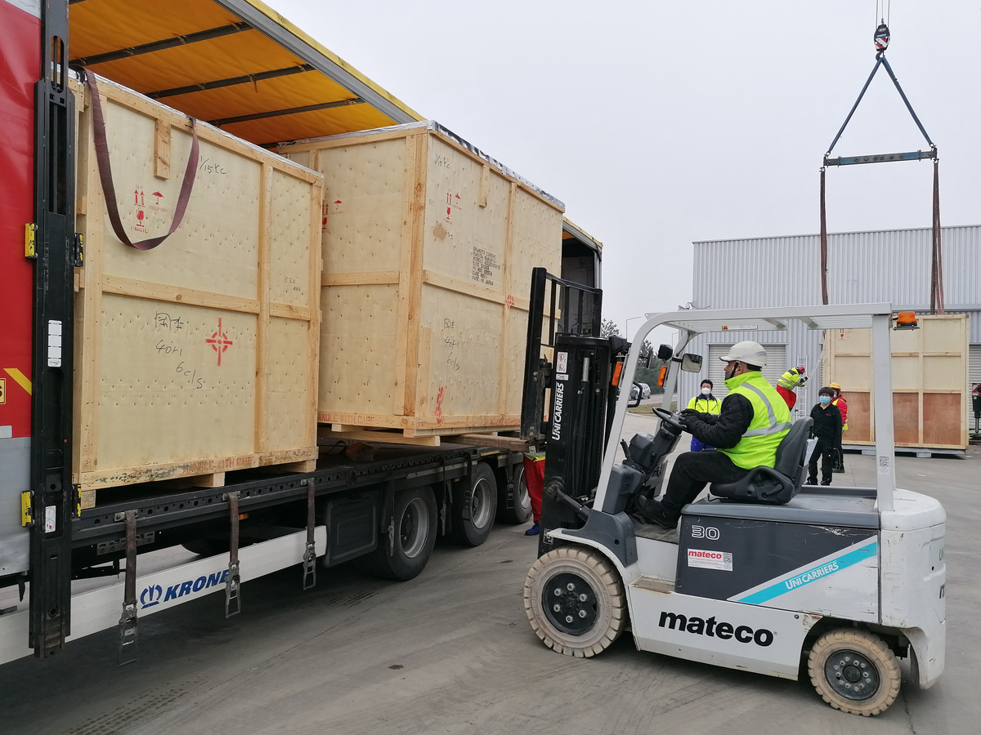
COMPLETED PROJECTS
OVERSIZED RAIL INFRASTRUCTURE
Stuffing, lashing and securing on 40FR
HIGH-PRECISION CUTTING MACHINE
Transport, unpacking and positioning in working position

Slide 8
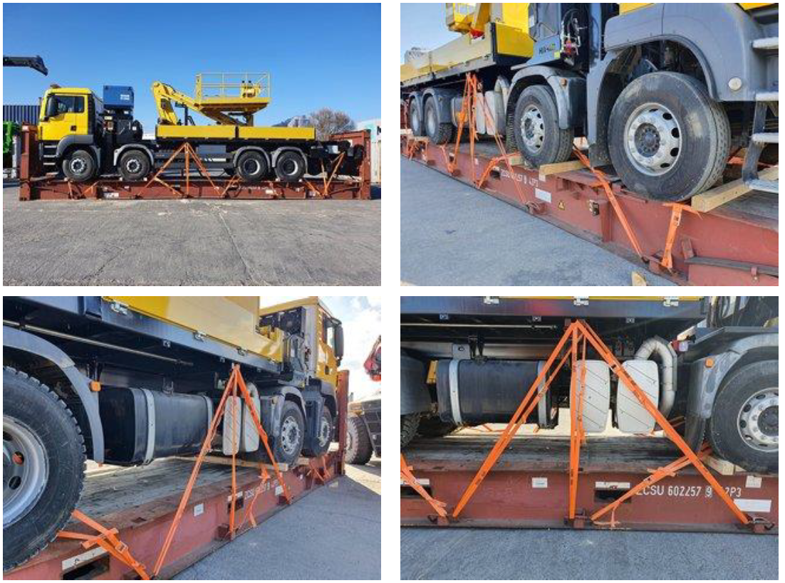
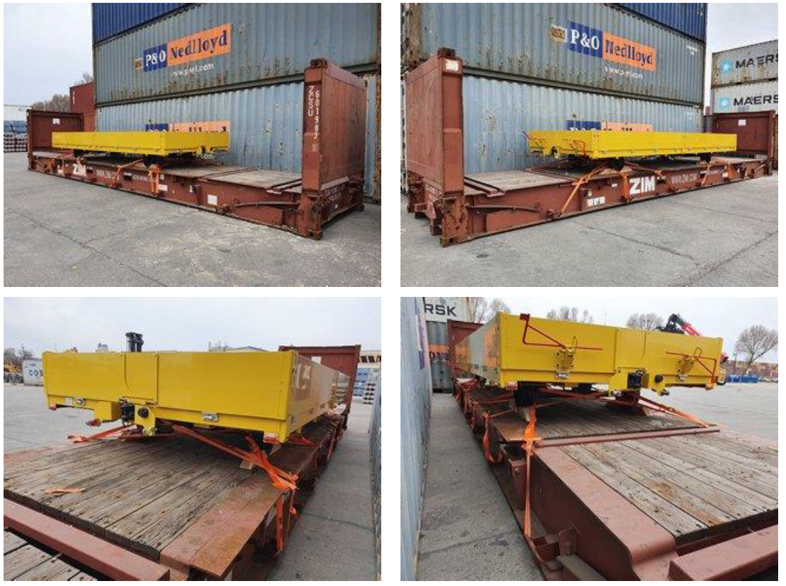
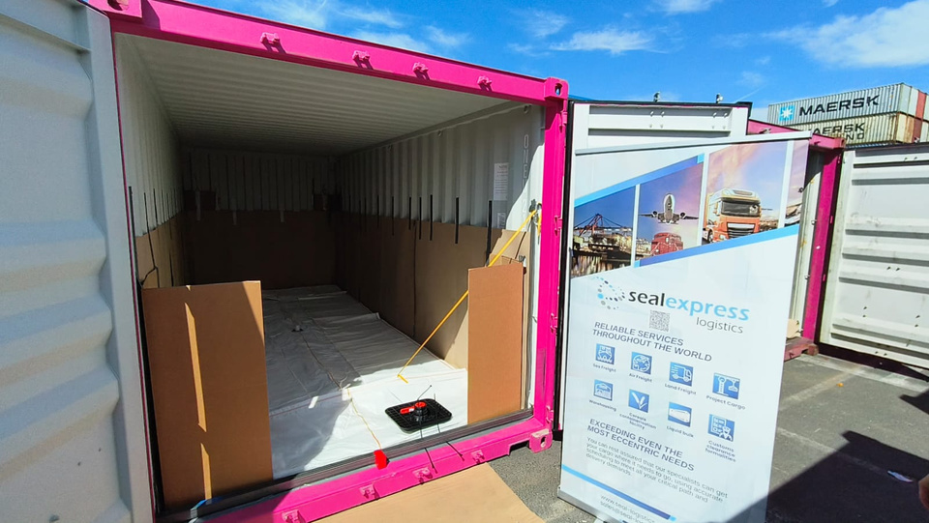
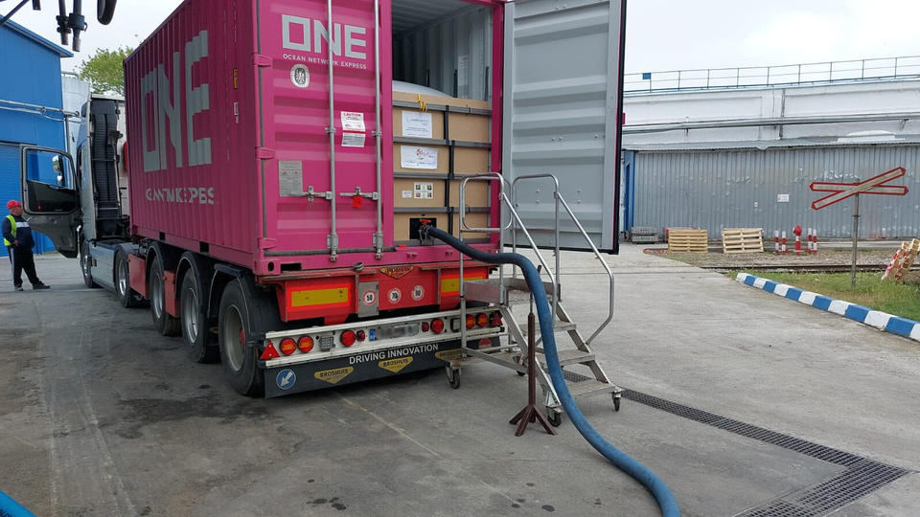
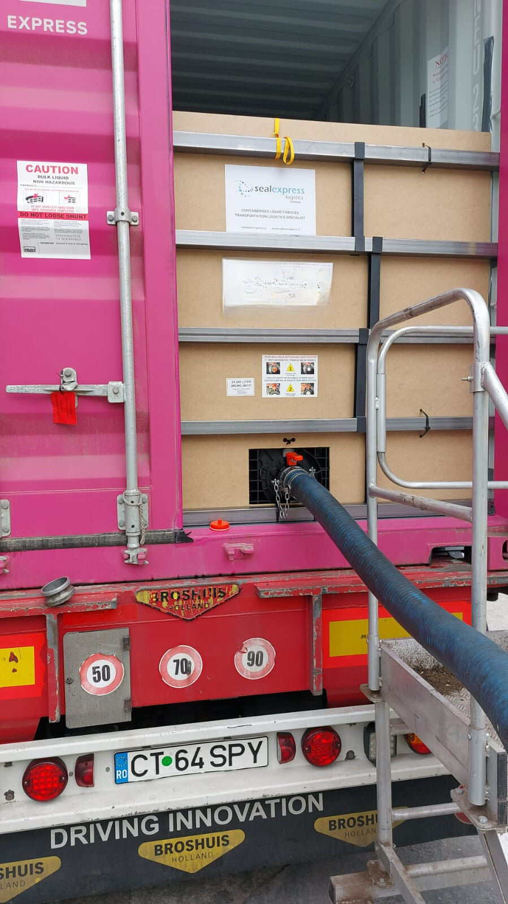
COMPLETED PROJECTS
TRU﻿CKS AND TRAILS
Stuffing, lashing and securing
RAPESEED OIL IN FLEXITANKS
Necessary logistics for flexitank containers

